Slide 1
Why Infovis?
03

Slide 2
Amount of Data Out There
1 000 000 000 000 000 000 000 bytes
http://www.emc.com/collateral/analyst-reports/expanding-digital-idc-white-paper.pdf

Slide 3
Data Age 2025 Report
IDC - Seagate, 2018

Slide 4
Amount of Data Out There
10²¹ bytes = 1 Zettabyte
http://www.emc.com/collateral/analyst-reports/expanding-digital-idc-white-paper.pdf

Slide 5
Amount of Data Out There
10²¹ bytes = 1 Zettabyte
EACH YEAR
(and growing)
http://www.emc.com/collateral/analyst-reports/expanding-digital-idc-white-paper.pdf

Slide 6

How To Cope?

Slide 7
Throughout this course we will use InfoVis and DataVis interchangeably

Slide 8
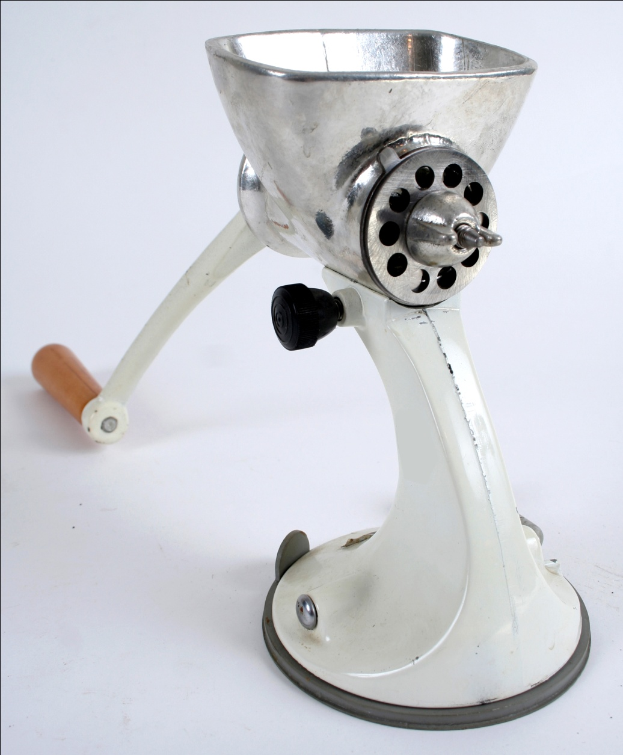
Transform Data into Information
peteralbre@sxc.hu

Slide 9
Visualize gives us insights
Anscombe Quartet
I |  | II |  | III |  | IV
x | y | x | y | x | y | x | y
10 | 8.04 | 10 | 9.14 | 10 | 7.46 | 8 | 6.58
8 | 6.95 | 8 | 8.14 | 8 | 6.77 | 8 | 5.76
13 | 7.58 | 13 | 8.74 | 13 | 12.74 | 8 | 7.71
9 | 8.81 | 9 | 8.77 | 9 | 7.11 | 8 | 8.84
11 | 8.33 | 11 | 9.26 | 11 | 7.81 | 8 | 8.47
14 | 9.96 | 14 | 8.10 | 14 | 8.84 | 8 | 7.04
6 | 7.24 | 6 | 6.13 | 6 | 6.08 | 8 | 5.25
4 | 4.26 | 4 | 3.10 | 4 | 5.39 | 19 | 12.50
12 | 10.84 | 12 | 9.13 | 12 | 8.15 | 8 | 5.56
7 | 4.82 | 7 | 7.26 | 7 | 6.42 | 8 | 7.91
5 | 5.68 | 5 | 4.74 | 5 | 5.73 | 8 | 6.8
http://astro.swarthmore.edu/astro121/anscombe.html
Notes:
Four datasets. The table doesn’t give us much to understand

Slide 10
Visualize shows us the details!
mean of the x values = 9.0
mean of the y values = 7.5
equation of the least-squared regression line is: y = 3 + 0.5x
sums of squared errors (about the mean) = 110.0
regression sums of squared errors (variance accounted for by x) = 27.5
residual sums of squared errors (about the regression line) = 13.75
correlation coefficient = 0.82
coefficient of determination = 0.67
http://astro.swarthmore.edu/astro121/anscombe.html
Notes:
If we try to abstract from the tables to make sense of them, we’ll find we’re losing A LOT of information
Plus, all the statistics are the same for all the four datasets!
So, we’ve lost the ability to tell them apart! Not so, with VIS

Slide 11
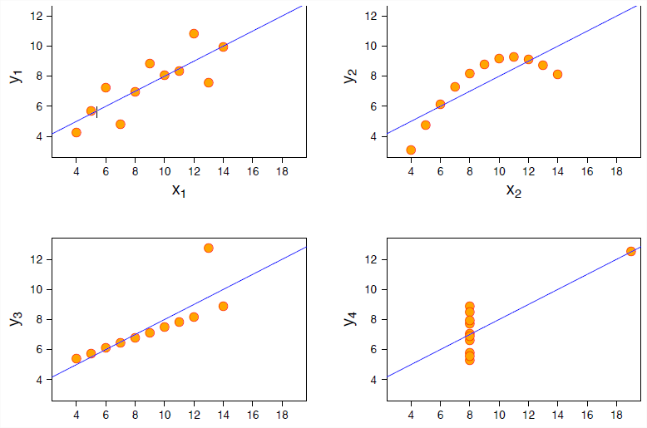
Visualize gives us insights
http://astro.swarthmore.edu/astro121/anscombe.html
Notes:
Visualize!

Slide 12

So, infovis is everywhere…

Slide 13
What IS INFOVIS?
01

Slide 14

Visualization
Ad4pt3r@sxc.hu

Slide 15
Visualize
form a mental image of something
to make perceptible to the mind

Slide 17
form a mental image of something
O0 00 000 000 000
to make perceptible to the mind

Slide 18
Readings in Information Visualization – Using Vision to Think
Stuart Card, Jock Mackinlay, Ben Schneiderman
Morgan Kaufmann, 1999

Slide 20
“The use of computer-supported, interactive visual representations of data to amplify cognition.”

Slide 21
Visualization Analysis and Design
Tamara Munzner
A.K. Peters / CRC Press, 2014

Slide 23
“Computer-based visualization systems provide visual representations of datasets designed to help people carry out tasks more effectively.”

Slide 25
“The use of computer-supported, interactive visual representations of data to amplify cognition.”
“Computer-based visualization systems provide visual representations of datasets designed to help people carry out tasks more effectively.”
visual representations
visual representations

Slide 27
“The use of computer-supported, interactive visual representations of data to amplify cognition.”
“Computer-based visualization systems provide visual representations of datasets designed to help people carry out tasks more effectively.”
visual representations
amplify cognition
visual representations
tasks

Slide 29
“The use of computer-supported, interactive visual representations of data to amplify cognition.”
“Computer-based visualization systems provide visual representations of datasets designed to help people carry out tasks more effectively.”
computer-supported
visual representations
amplify cognition
Computer-based
visual representations
tasks

Slide 30
Custom

Slide 31
Concrete Questions

Slide 32
Actionable Information

Slide 33
Information Visualization
“The use of computer-supported, interactive visual representations of data to amplify cognition.”
- Card, Mackinlay Shneiderman 98

Slide 34
Information Visualization
“Computer-based visualization systems provide visual representations of datasets designed to help people carry out tasks more effectively.”
- Munzner, 2014

Slide 35
Information Visualization
“The use of computer-supported, interactive visual representations of data to amplify cognition.
“Computer-based visualization systems provide visual representations of datasets designed to help people carry out tasks more efectively.”

Slide 36
Information Visualization
“The use of computer-supported, interactive visual representations of data to amplify cognition.
“Computer-based visualization systems provide visual representations of datasets designed to help people carry out tasks more effectively.”

Slide 37

Vision is a high-bandwidth sense

Slide 38
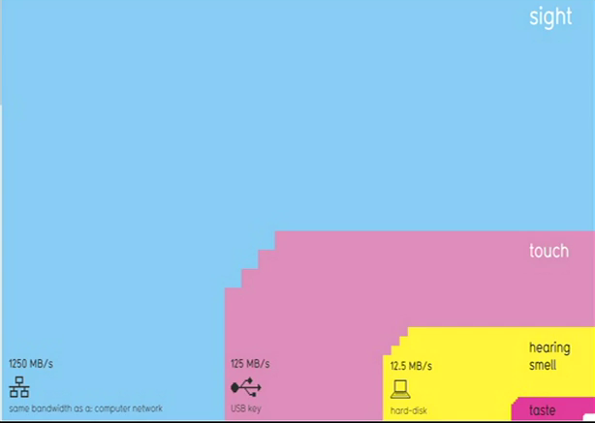
Sight Rules!

Slide 39
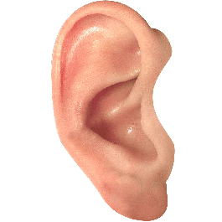



What about the other senses?
Not good for parallel apprehension of data. Low bandwidth
Technical limitations

Slide 40
Information Visualization
“The use of computer-supported, interactive visual representations of data to amplify cognition.
“Computer-based visualization systems provide visual representations of datasets designed to help people carry out tasks more effectively.”

Slide 41

A Human in the Loop
The vis in itself tells little, it needs to be interpreted

Slide 42


A Human in the Loop
Vis not necessary when trusted fully automatic solution exists
Vis good for ill-specified problems
Notes:
If we are not entirely sure of what we’re looking for, exploratory analysis, etc.

Slide 43
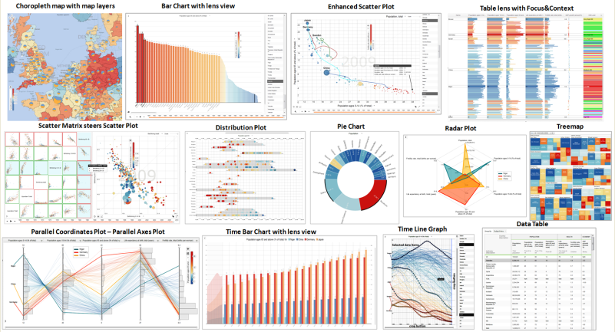
The importance of Tasks
Tasks constrain design
Not all visualization techniques work for all tasks
challenge: recast tasks from domain-specific vocabulary to abstract forms

Slide 44
Talk about Infographics
Even some old ones, manually drawn
Something missing: COMPUTER, Interactivity!

Slide 45
Information Visualization
“The use of computer-supported, interactive visual representations of data to amplify cognition.
“Computer-based visualization systems provide visual representations of datasets designed to help people carry out tasks more effectively.”

Slide 46
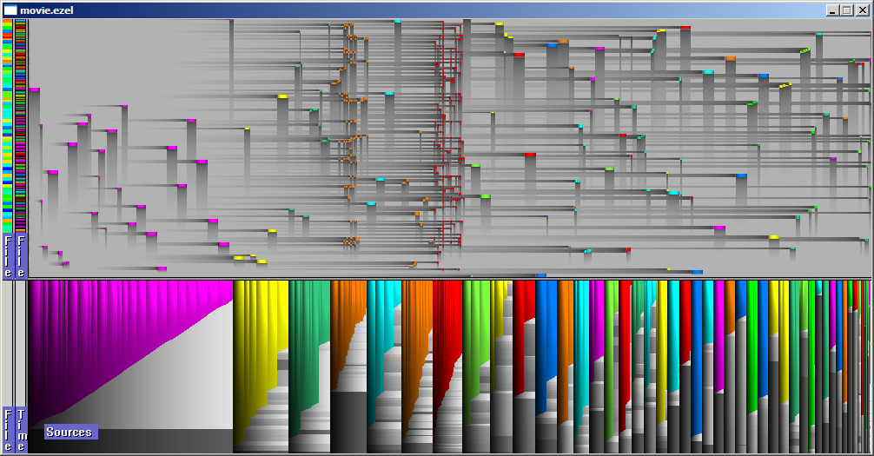
A Computer in the loop
Efficiency, patience, interactivity
Notes:
Needed to display and explore huge datasets
(drawing it by hand would be a daunting task)

Slide 47
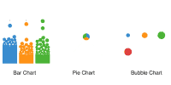
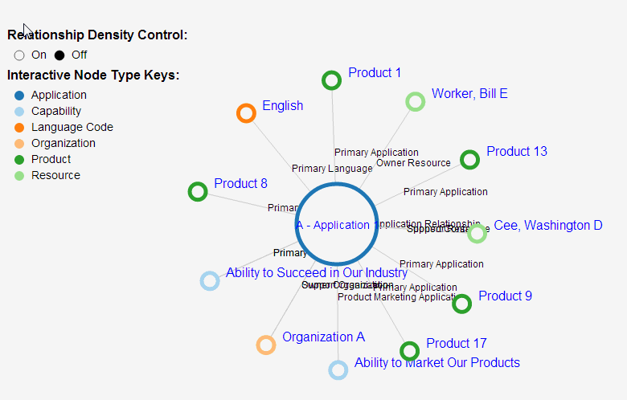
Animations, Interactivity
Notes:
Preetify
Help follow changes (avoid sudden jumps)
Fit large datasets onto limited screen real-estate
And…

Slide 48

Interactivity
Different Views on the Data

Slide 49
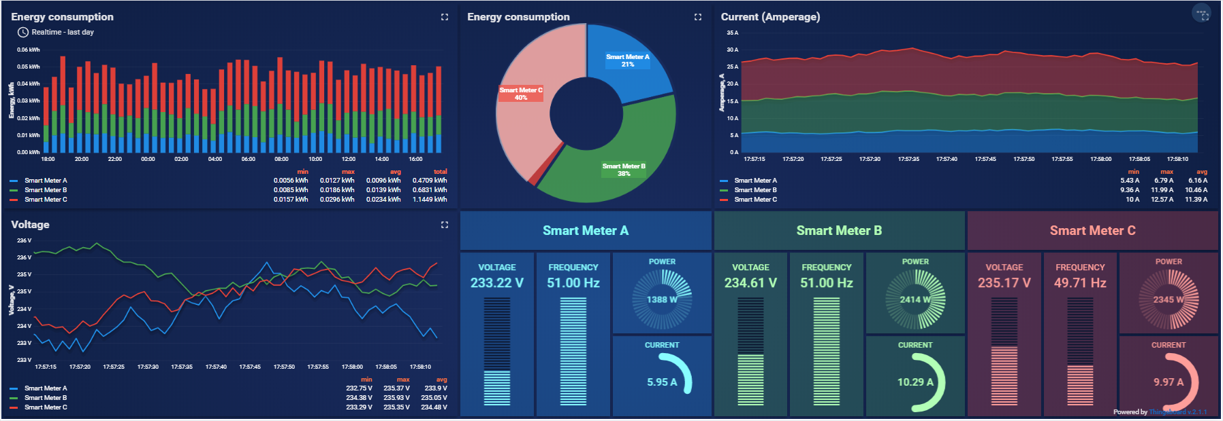
Canned solutions…
https://thingsboard.io/smart-energy/
Notes:
The typical solution: a dashboard
How much stuff can you see at once? How fast can it change? Limited!

Slide 50

So Cute!

Slide 51

Get Over Cute!

Slide 52
InfoVis…
CUSTOM

Slide 53
InfoVis…
CONCRETE QUESTIONS

Slide 54
InfoVis…
ACTIONABLE ANSWERS

Slide 55
What it isn’t!

Slide 56
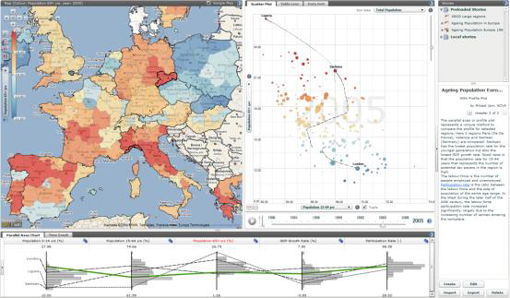
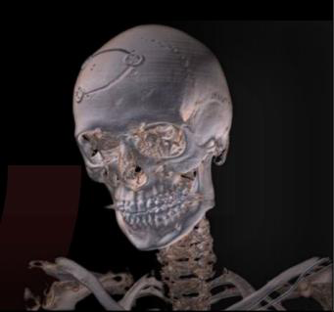
InfoVis vs Scientific Visualization
Notes:
SciVis representa normalmente coisas concretas do mundo físico
Normalmente, são dados com localização espacial intrínseca (leitos de rios, imagem médica, etc.)
Em SciVis queremos representar fielmente a realidade
Em SciVis os dados têm localização intrínseca e devem ser representados nela
Em InfoVis queremos abstrair dos dados
Em InfoVis o layout dos dados é decidido pelo designer

Slide 57

InfoVis vs. “Visualization” (aka Computer Graphics)

Slide 58
Content and Presentation
Prof. Daniel Gonçalves
Technical Production
Pedro Quintas
InfoVis Team
João Moreira
Tomás Alves
Rita Marques

Slide 59
Content Sources
Harvard Business Review
Visualizations That Really Work
https://hbr.org/2016/06/visualizations-that-really-work
Pinterest
https://europedaily.org/publico/?lpkey=15d195a02773161e33&uclick=2ta3a29rwj
Ben Fraser
https://www.mrbenfraser.com/art-direction-_-infographics
Wikipedia
https://en.wikipedia.org/wiki/Anscombe%27s_quartet
Stock Footage by Videezy
https://www.videezy.coM
Stock Footage by Mixkit.co
https://mixkit.co/

Slide 60
Content Sources
Stock Footage by Cottonbro, Pexels
https://www.pexels.com/
Stock Photos by YongGuang Tian, Alex Litvin at Unsplash
https://unsplash.com/
Mike Bostok
https://observablehq.com/@d3/brushable-scatterplot-matrix,
https://observablehq.com/@d3/dot-plot
https://observablehq.com/@d3/stacked-to-grouped-bars
Additional Footage available under a CC license at
https://www.youtube.com/watch?v=JrP9m7Ujuoc, by virengos
https://www.youtube.com/watch?v=jVc_u7B8v6k, by Intruu
https://www.youtube.com/watch?v=YDchUBViYvk, by DrRhysy
https://www.youtube.com/watch?v=aqz-KE-bpKQ, by Blender Fond.

Slide 61
Additional References
Data Age 2025 – The Digitization of the World From Edge to Core
IDC / Seagate Report, 2018
Theme Song
“Pop Metal” by Jason Shaw, at audionatutix.com
https://audionautix.com/
© 2020 Daniel Gonçalves

